Slide 1
Monday, August 22, 2016
Write In Your Agenda:
Write In Your Monitoring Log:
CW:
Finish CERC flipbook
Layers of the Earth Reading and Notesheet
HW:
None
Response to Warm-Up:
How did you learn about the layers of the Earth in elementary school?
You will need:
Pencil
CERC Flipbook
New Monitoring Log
Hand in last week’s Monitoring Log

Slide 2
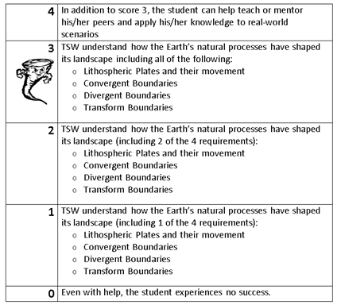
Learning Goal and Scale
TSW understand how the Earth’s natural processes have shaped its landscape (including Lithospheric Plates and their movement, Convergent, Divergent, and Transform boundary landforms).

Slide 3
Layers of the Earth
Take 10 minutes to brainstorm with your table about what you already know about layers of the earth.
Record them on the whiteboard.
Choose a spokesperson for your table for when we share out.

